Slide 1
Welcome to ….
2016 Frank P. Moolin Seminar
Environmentally Sustainable Construction Practices in Cold Regions

Slide 2

With thanks to … co-managers
Ty Wardell, EIT, President
Brian Lamson, P.E.

Slide 3

UAF College of Engineering and Mines
Dr. Doug Goering, P.E., Dean

Slide 4

and our sponsors …
John MacKinnon, Executive Director.
Anna Jespersen, Fairbanks Branch Manager

Slide 5

Institute of Transportation Engineers, Alaska Section
Erica Jensen, P.E., President
Robert DeVassie, P.E.

Slide 6

Alaska Tribal Technical Assistance Program
Byron Bluehorse, Program Manager

Slide 7

Dr. Jenny Liu, P.E., Director
Joe Alloway, Outreach Coordinator

Slide 8

American Society of Civil Engineers, Alaska Section
Steven Nuss, P.E., President

Slide 9
And many thanks to our 13 speakers!

Slide 10
Review the agenda, briefly …

Slide 11
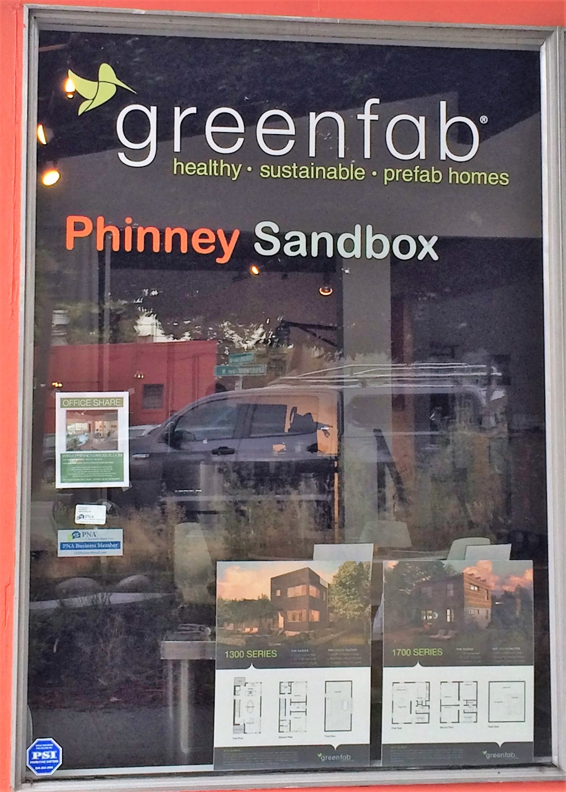
Design?
Construction?
O & M?

